Slide 1
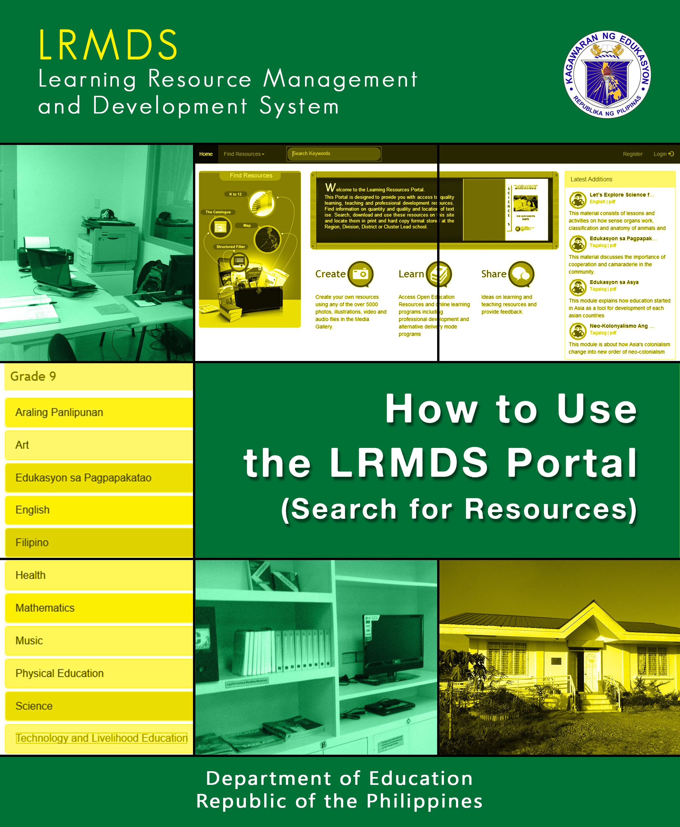

Slide 2
Education is not the filling of a pail,
but the lighting of a fire.
- William Butler Yeats

Slide 3
How to Use the LRMDS Portal
(Search for Resources)

Slide 4
1. Go to the LRMDS portal by typing lrmds.deped.gov.ph on the address bar.

Slide 5
2. Type the lesson or a keyword in the search bar.
Tip: You can add the grade level after the topic to search for
a specific grade level (i.e., “Science 7”, “Math 9”, etc...)

Slide 6
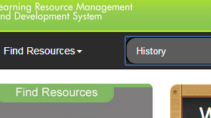
3. Search a general or specific category.
General Search Specific Search

Slide 7
4. Type the topic, press Enter, and look at the search results.

Slide 8
5. Move cursor the “View” and click the material you wish to see.

Slide 9
6. After clicking “View,” you will see general information about the material.

Slide 10
7. Click the tabs below the “More Information” section to view more details about the material.

Slide 11
8. Click the “Download” button to download the material from the portal.

Slide 12
If you’re using Google Chrome...
After downloading, click on the side*, and select “show in folder.”

Slide 13
If you’re using Mozilla Firefox, an option window will appear after clicking the download button.
Click on the button beside “Save File.”

Slide 14
After downloading, click the down arrow on the upper left corner of the browser, then click the round folder button.

Slide 15
If you’re using Internet Explorer...
After clicking the “Download” button, click “Save.”

Slide 16

After downloading, click the “Open Folder” button.

Slide 17
Click the file you just downloaded which will open using the software that reads the format of the resource (e.g., PDF, .docx, .ppt., etc.)

Slide 18


